Slide 2
This workshop is being recorded and will be made available on our website,
CSDisseminate.com

Slide 3
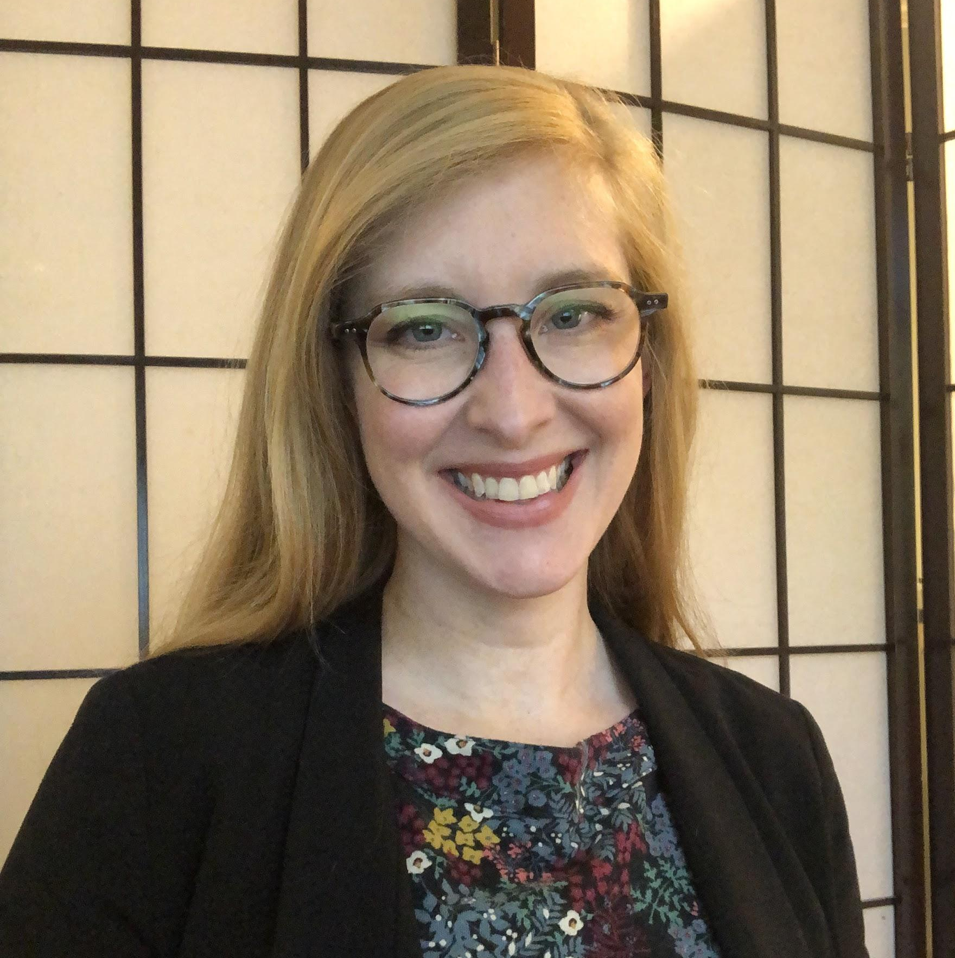
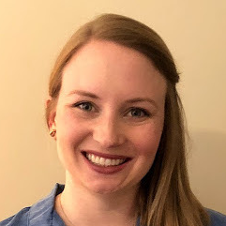
The team
Elaine Kearney,
PhD
Helen Long,
PhD, CCC-SLP
Mariam El Amin, MS-SLP
Meredith Harold, PhD, CCC-SLP
Mary Alice Keller, MA, CCC-SLP
James Borders,
MS, CCC-SLP
Merry Spratford, AuD, CCC-A

Slide 4
Outline
Background
Self-archiving steps
Breakout sessions and Q+A

Slide 5
What is CSDisseminate?
A grass-roots initiative started by a group of volunteer scientists and clinicians to support the accessibility of research in the field of Communication Sciences and Disorders (CSD).
Our goal is to provide CSD scientists with resources to learn how to make their research accessible.
The goal of today’s workshop is to introduce you to self-archiving free, legal versions of your manuscripts.

Slide 6
Poll
How much experience do you have self-archiving?
1
2
3
4
Novice
Beginner
Intermediate
Expert
What’s self-archiving? I haven’t started, yet.
I’m currently learning the process of self-archiving.
I’ve started self-archiving, but don’t do it regularly.
I regularly self-archive on my own website or institutional repository.

Slide 7
What is self-archiving?
The act of making a version of a manuscript available on a personal or institutional website with free access for those interested.
Depending on journal policies, the version may be the submitted, accepted, or published version of a manuscript.
Self-archiving is also called “green open access”, and differs from “gold open access” where you pay fees to a publisher to make your work open access.

Slide 8
UPTAKE OF FINDINGS
Other researchers
Clinicians
Policy-makers
HYPOTHESIS GENERATION
Research life cycle
WRITE-UP & DISSEMINATION
DATA COLLECTION
DATA ANALYSIS & INTERPRETATION

Slide 9
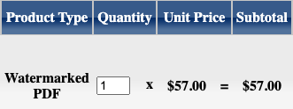
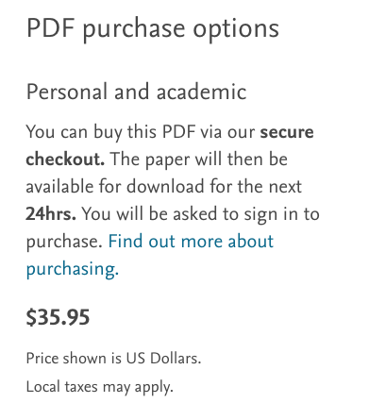
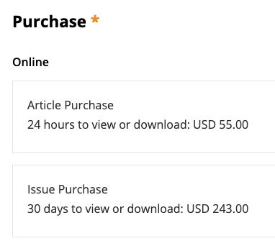
Without institutional access...

Slide 10
Without institutional access...
All interested researchers cannot read your work
→ inefficiencies in scientific process
Clinicians cannot read your work
→ significant barrier to staying on top of current evidence and implementing evidence-based practise (Thome et al., 2020)
→ 17 years from research to clinical uptake (Balas & Boren, 2000)
Policy-makers cannot read your work
→ system-level change cannot happen

Slide 11
Why authors?
I don’t have time to create a website.
You, as authors of research papers, are the only people who retain the right to self-archive. No one else can do it on your behalf.
People can just email me for a copy.
My lab doesn’t have funds for open-access.
We are already overburdened.

Slide 12
There are benefits to you, too
Self-archiving:
Is free — allowing you to maximally invest grant funding in research and trainees
Is associated with a citation benefit — 30% more citations than research that is made open-access by paying a publisher fee (Piwowar et al., 2018)
Increases visibility of your work and ability to reach new audiences outside of academia

Slide 13
Self-archiving steps
Brush up on the key terms
Find the copyright policies of your publisher/journal
Identify which version of the manuscript you can self-archive
Identify when you can self-archive
Identify where you can self-archive
Self-archive!
WHAT

Slide 14
Step 1: Key terms
Self-archiving is the act of making a version of a manuscript available on a personal or institutional website with free access for those interested.
Depending on publisher policies, the version may be the submitted, accepted, or published version of a manuscript.

Slide 15
Step 1: Key terms
Submitted version (preprint)
Has not undergone peer review
Published version (offprint)
Peer-reviewed, formatted by publisher, available on journal website
Submitted
Accepted version (postprint)
Peer-reviewed and accepted for publication, but not yet formatted by the publisher

Slide 16
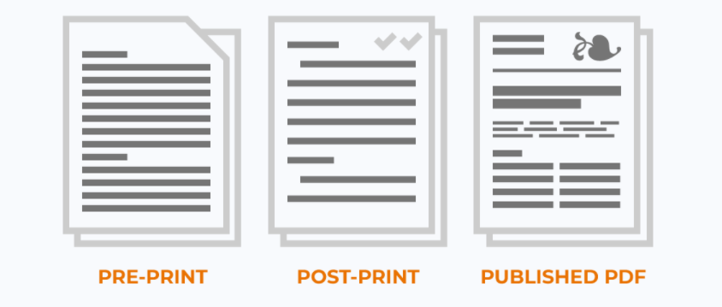
Versions of your manuscript
openaccessbutton.org/versions-explained

Slide 17
Step 2: Find the copyright policies of your publisher or journal
All publishers have slightly different rules, but they are easy to find with the following websites:
Sherpa Romeo: https://v2.sherpa.ac.uk/romeo/
How Can I Share It?: https://www.howcanishareit.com/
ShareYourPaper: https://shareyourpaper.org/
When in doubt, search the submission guidelines of a journal for “self-archiving policy” or “preprint policy”

Slide 18
Step 2: Find the copyright policies of your publisher or journal
You may want to keep track of what you find in a spreadsheet:
CSDisseminate template

Slide 19
Step 3: Which version can you self-archive?
You’ll find which version you can self-archive in the copyright policy:
Submitted
Accepted
Published

Slide 20
Step 4: When can you self-archive?
You’ll find when you can self-archive accepted/published manuscripts in the copyright policy:
At the time of publication (no embargo)
Following an embargo
A period of time when sharing a version of the article is not allowed
Most often 6-12 months post-publication date
It’s most common to post submitted versions to preprint servers before or at the time of journal submission.

Slide 21
Step 5: Where can you self-archive?
You’ll find where you can self-archive in the copyright policy:
Preprint servers
Institutional repository
University laboratory website and/or your own website
These are not the only places you can self-archive but are usually the most permissive and the most accessible to the general public.
To access articles on ResearchGate, for example, you need an institutional email address to create an account.

Slide 22
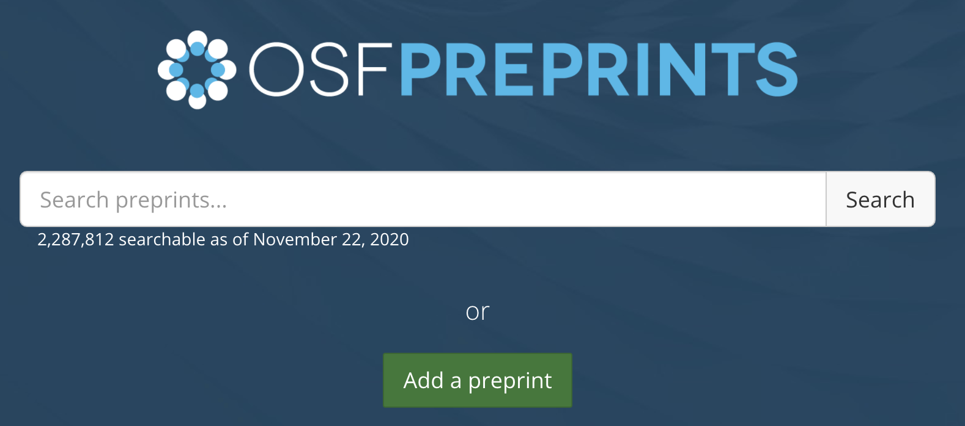
Step 5: Where can you self-archive?
Preprint servers:
Websites where you can upload the submitted version of a manuscript
Popular examples in CSD include:
BioRxiv
Open Science Framework (OSF)
PsyArXiv

Slide 23
Step 5: Where can you self-archive?
Preprint servers:
Benefits:
Increased visibility of your work
Early feedback from peers
Citable DOI prior to publication in a journal

Slide 24
Step 5: Where can you self-archive?
Preprint servers
Cons:
Some journals do not accept preprint manuscripts
Check journal submission policies ahead of time
Some preprint servers do not allow revision updates to the manuscript
Check policies regarding updating preprint version
Media uptake of non-peer-reviewed work can have unintended consequences

Slide 25
Step 5: Where can you self-archive?
Institutional repository
Your institution may have:
Its own digital repository where you can upload your manuscripts
Services to assist you in the process of uploading and sharing your work
Guidance to help you adhere to publisher policies

Slide 26
Step 5: Where can you self-archive?
Your own website
Your institution may be able to provide resources to create a professional or lab page
Alternatively, you can build your own
Colleagues and clinicians can quickly access your research
Website builders offer templates
Wix, Squarespace, Weebly, and Google Sites
Low cost, user-friendly, and easy to maintain

Slide 27
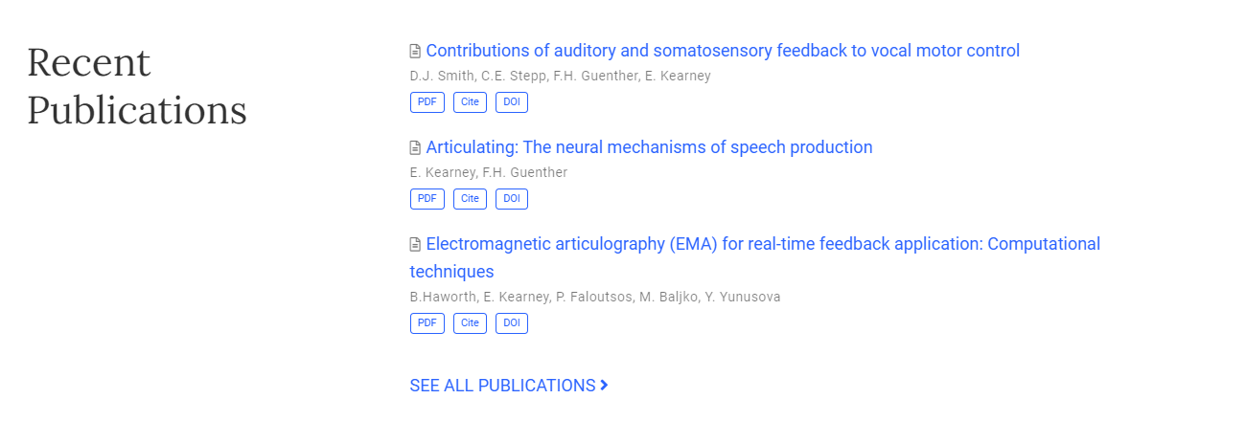
Elaine’s website
www.elaine-kearney.com

Slide 28
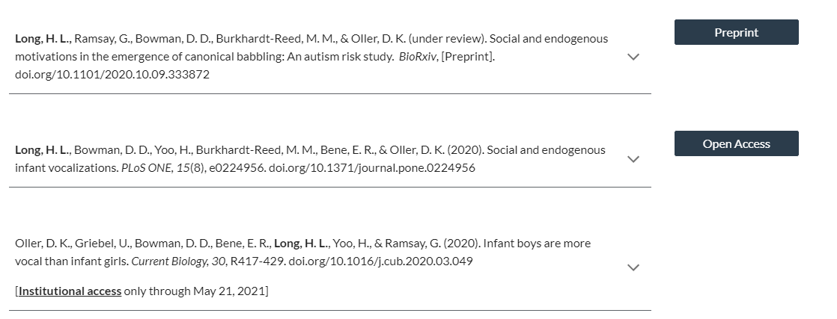
My website
www.helen-long.com

Slide 29
Step 5: Where can you self-archive?
Your own website
10-minute demo on our website
Check out our featured scientists for great examples
Dr. Megan Roberts, PhD, CCC-SLP
Dr. Kelly Farquharson, PhD, CCC-SLP

Slide 30
Searching for journal policies example:
Sherpa Romeo: https://v2.sherpa.ac.uk/romeo/

Slide 31
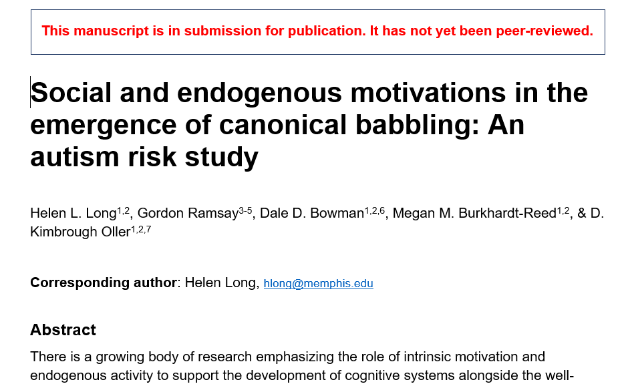
Step 6: Self-archive!
Submitted version
Post the submitted manuscript to a preprint server or your website.
Option to add a preprint tag
Post the preprint citation, DOI link, to your personal website or institutional repository.

Slide 32
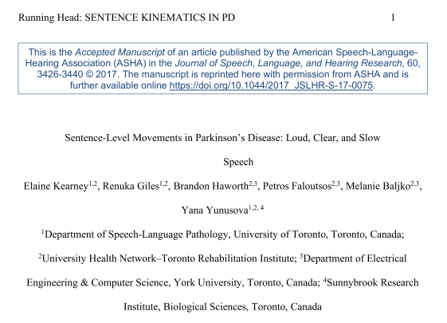
Step 6: Self-archive!
Accepted version
Attach a user license to the first page of your accepted manuscript
Post the full citation, DOI link, and accepted manuscript PDF to your personal website or institutional repository.

Slide 33
Step 6: Self-archive!
Published version
Post the full citation, DOI link, and publisher PDF to your personal website or institutional repository.
*Different from Gold Open Access

Slide 34
All steps are listed on our website!
www.csdisseminate.com

Slide 35
Breakout rooms: Let’s try it!
For a recent publication from someone in your breakout room:
Brush up on the key terms
Find the copyright policies of your publisher/journal
Identify which version of the manuscript you can self-archive
Identify when you can self-archive
Identify where you can self-archive
Self-archive!

Slide 36
Q+A
Does author order matter or can I self-archive as, for example, third author? Can I self-archive if I am not the PI of the grant from which the data derives?
All authors can self-archive. We do recommend getting all authors’ permission to self-archive, and you may need to check with the corresponding author that you have the correct version of the manuscript.

Slide 37
Q+A
Can you self-archive on multiple platforms (e.g., personal website, university website) or do most journals restrict how many places you can post a copy of your manuscript?
There are typically no restrictions on the number of places you self-archive but often the conditions vary by place. You may be allowed to post the accepted version on your personal website but only the submitted version elsewhere. Always check the journal policies.

Slide 38
Q+A
What are the pros/cons of self-archiving compared to making your research open access via the journal?
Self-archiving is free, associated with a 30% increase in citations, and expands your reach to include non-academic audiences.
It takes some time and effort but hopefully we’ve shown you that it’s relatively easy to do.

Slide 39
Q+A
Is there a difference in when or why someone would self-archive vs use open access vs publish to a journal with a paywall?
Most journals allow self-archiving a version of a manuscript, however, some do not. That may be a reason to either publish gold open access or choose a different journal that allows self-archiving.

Slide 40
Q+A
Are there any key differences between US and Europe?
The information we presented in this workshop is applicable globally. There may be differences in what is required by funders in the US and Europe, e.g., if, when, and where researchers are expected to self-archive.

Slide 41
Q+A
Does self-archiving lessen the need for peer review?
Self-archiving does not in any way replace the need for peer review. Instead, it increases access to research at different points in the publication process (before and after peer review).

Slide 42
Q+A
What ethical issues are there to consider related to self-archiving?
Always seek out individual journal policies, understanding embargo rules, and getting all authors’ permissions to self-archive.

Slide 43
Breakout rooms: Action plan
We realize this has been a lot of information! Let’s start small…
What is one long-term goal (1 year from now)?
“Create a professional website”
“Add free, legal versions of all publications to my website”
What are three short-term goals (1/month over next 3 months)?
“Compile the journal policies for my 2020 publications”
“Locate versions of my research that I can legally self-archive”
“Compare two website builders”
Who will help keep you accountable?
Action plan document

Slide 44
Thank you for attending!
Watch your email for a follow-up survey.
Repeat workshop on Thursday, 7pm CT.
We are here for you! Please get in touch if you are stuck, have questions, or want to learn more about what we do.
www.CSDisseminate.com
CSDisseminate@gmail.com

